Slide 1
Zero-knowledge Proofs
By: Parker Blue & Ethan Cox
Notes:
both

Slide 2
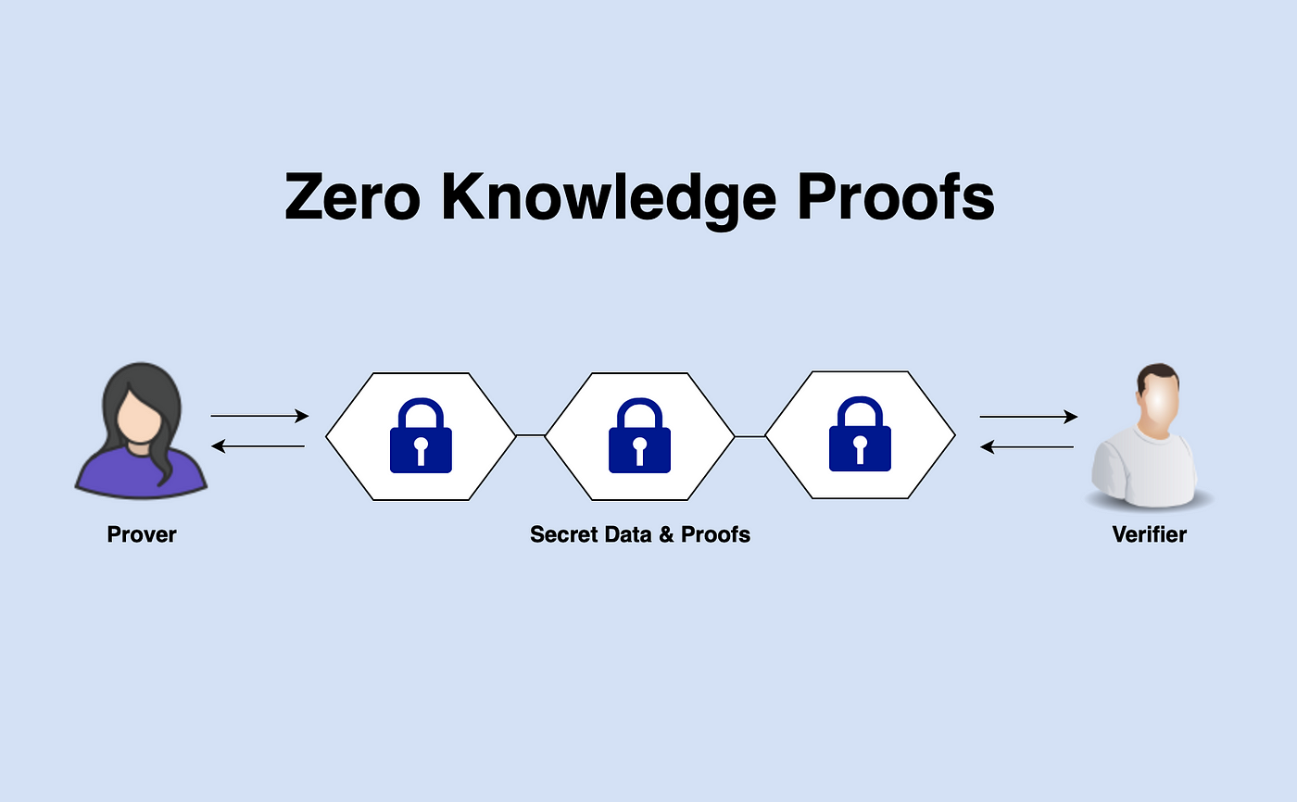
Table of Contents
Introduction
Interactive Proof Systems
Zero-knowledge Proofs
Live Demonstration
Undeniable Signatures
Other Applications
- NP Complete
- Quality of a protocol rather than a protocol itself
Notes:
Both

Slide 3
Introduction
Originally Developed in 1988 as a follow up to Arthur-Merlin Communication/protocol
A technique for proving a statement to be true without revealing any other information
Known as an “interactive proof system”
Must satisfy three properties:
Completeness - If prover is convincing (true), verifier is convinced
Soundness - If false, no prover tricks verifier (except with minute probability)
Zero-Knowledge - If statement is true, that is all the verifier learns
Notes:
Parker
Completeness: if a statement is true, if the person proving (prover) is convinced he knows, the person listening for proof (verifier) should also be convinced.
Soundness: if a statement is false, no prover can convince an honest verifier that it is true, except with some small probability
Zero-knowledge: if the statement is true, no verifier learns anything other than the fact that the statement is true

Slide 4
Relevant Terminology
Interactive Proof System (Challenge/Response)
A system where a prover tries to convince a verifier that a given statement is true
Zero-knowledge Proof:
An interactive proof system where the verifier proves that a statement is true without providing any other information about the thing itself
Public-key Cryptography:
a cryptographic system based on a pair of a public and private key
Notes:
Parker
Define challenge/response

Slide 5
A Brief History
“The Knowledge Complexity of Interactive Proof-Systems” - paper by Goldwasser, Micali, and Rackoff
Wins first Gödel Prize in 1993 for theoretical computer science
Ben-Or et al. proved any interactive proof system can be proved in zero knowledge, causing explosion of further research
Led to creation of non-interactive zero-knowledge, allowing independent verification or asynchronous verification
Development of multi-prover interactive proof systems allowed verifier to examine all of them at once in isolation further limiting falsification
Used today in blockchain (non interactive)
Notes:
parker

Slide 6
Interactive Proof Systems
A computational model where one person (the prover) tries to convince another person (the verifier) that a given statement is true through a series of challenges/responses
After x interactions, the verifier chooses to accept or reject the prover’s claim that the given statement is true based on the set of all responses up until that point
An interactive system must be complete and sound
Complete: the verifier must be able to be convinced of a true statement
Sound: the verifier must only have a small probably to accept a false statement
Notes:
Ethan

Slide 7
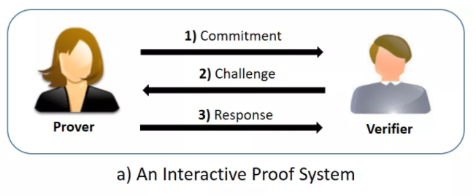
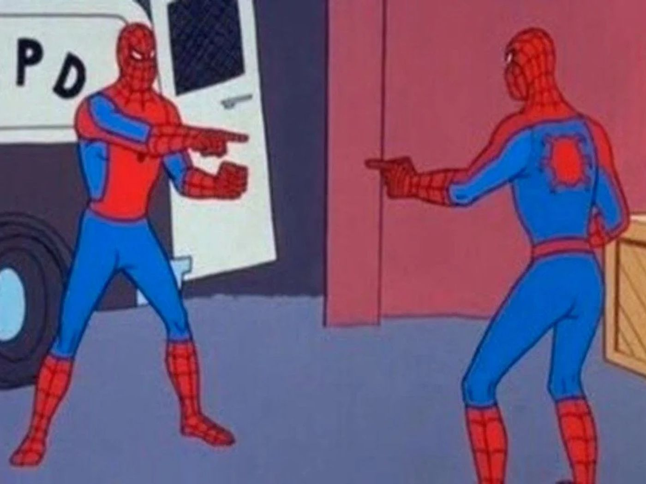
Diagram of an Interactive Proof System
Notes:
Ethan

Slide 8
Arthur-Merlin Protocol
Developed in 1985
Interactive Proof system, but with a catch:
Verifiers constrained to public (prover allowed to access verifiers results)
More theoretical than useful
Used to to prove all interactive proof systems with private statements have equivalent public solutions as well
Notes:
Parker

Slide 9
Zero-knowledge Proofs
Traditional proofs result in the verifier gaining some knowledge
Statement (prover): “26781 is not a prime number”
Disproof (prover): “113 x 237 = 26781, therefore it is composite”
Result: verifier gains some knowledge (26781 is composite)
A type of interactive proof (a complete and sound) proof that is additionally zero-knowledge. Upon being convinced, the verifier will gain no knowledge, making the secret irreproducible
The prover must convince the verifier that the statement is true without revealing any other information. The statement is limited to the claim that the prover knows some secret
Notes:
Ethan
The verifier must not be able to convince any other party that the statement is true
Claim: “26781 is a prime number”
Disproof: “113 x 237 = 26781, therefore it is composite”
RESULT: verifier gains some knowledge (26781 is composite)

Slide 10
Zero-knowledge Proofs Cont.
Not a protocol but a quality of a protocol. It is essential for the anonymity authentication behind protocols like ZK-SNARK and ZK-STARK (used in cryptocurrency)
Zero-knowledge proofs are distinct from mathematical proofs because the verifier determines the statement is likely—not certain—to be true
Many protocols that use zero-knowledge proofs use blinding to hide their inputs and outputs with a bijective encoding function E
Notes:
Ethan

Slide 11

NP-complete
short for "nondeterministic polynomial-time complete"
A decision problem is NP-complete if:
is in NP
Every problem in NP is reducible to in polynomial time.
NP - the set of all decision problems whose solutions can be verified in polynomial time
Decision problem - yes/no
Although a solution to an NP-complete problem can be verified "quickly", there is no known way to find a solution quickly (P vs NP, different topic)
Notes:
Parker

Slide 12
Showcase (In-class Example)
Idea: convince Parker that I know the markers are two different colors without revealing what colors the markers are (he gains zero knowledge)
Notes:
Both
Statement: the markers are two different colors
Secret: I do not reveal what two colors the markers are
Method: If the markers are different colors, then I can determine whether or not Parker swaps the markers behind his back with perfect accuracy
Verification: Parker asks me verify whether or not he swapped the two markers until the probability of guessing blind is so unlikely that he is convinced I know the markers are different colors. Parker makes his judgement based on the set of correctly- and incorrectly-guessed swaps

Slide 13
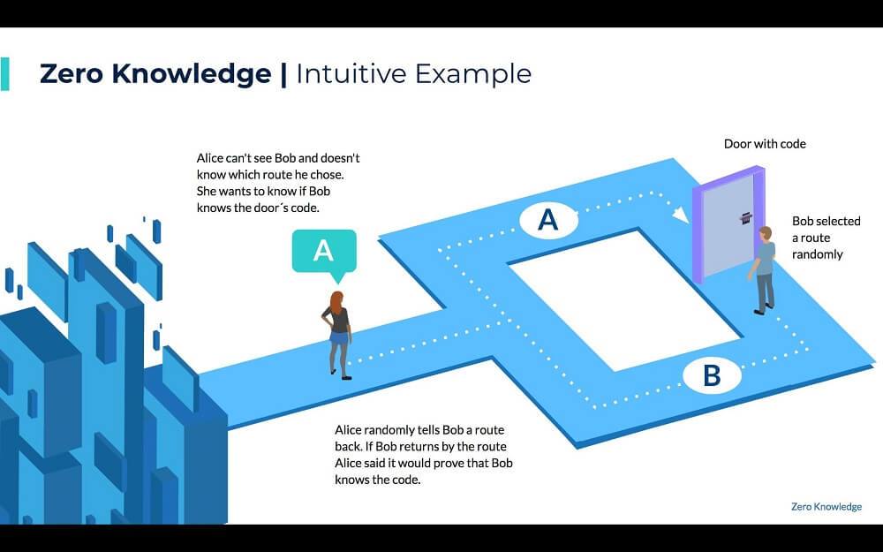
Notes:
Ethan
Graphical example of the Ali Baba Cave
Your digital signature method is not zero knowledge because Alice just revealed that she knows the private key. Even if she didn't reveal what the private key is.
A common explanation of zero knowledge is the story of the Ali Baba cave. The paper goes in depth, starting in the "Jealous Reporter" section, to highlight that not only is the secret hidden, but also the knowledge that someone could have the secret is also hidden.

Slide 14
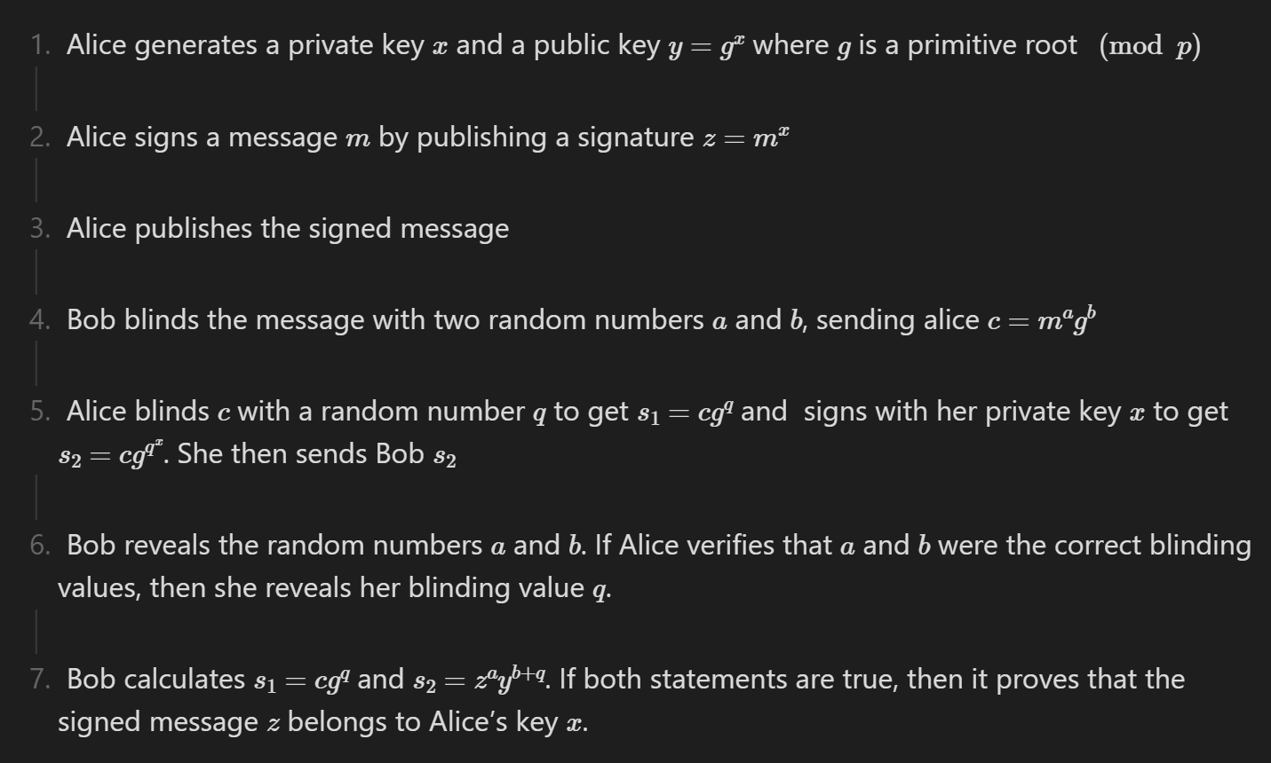
Mathematical Foundation
Notes:
Bob picks two random numbers: a and b, and uses them to blind the message, sending to Alice: c = mªg^{b}.
Alice picks a random number, q, uses it to blind, c, and then signing this using her private key, x, sending to Bob: s₁ = cg^{q} and s₂ = s₁^{x}. Note that s₁^{x} = (cg^{q})^{x} = (mªg^{b})^{x}g^{qx} = (m^{x})ª(g^{x})^{b+q} = zªy^{b+q}.
Bob reveals a and b.
Alice verifies that a and b are the correct blind values, then, if so, reveals q. Revealing these blinds makes the exchange zero knowledge.
Bob verifies s₁ = cg^{q}, proving q has not been chosen dishonestly, and s₂ = zªy^{b+q}, proving z is valid signature issued by Alice's key. Note that zªy^{b+q} = (m^{x})ª(g^{x})^{b+q}.
Another implementation that employs Zero Knowledge proofs
It was invented by David Chaum and Hans van Antwerpen in 1989

Slide 15
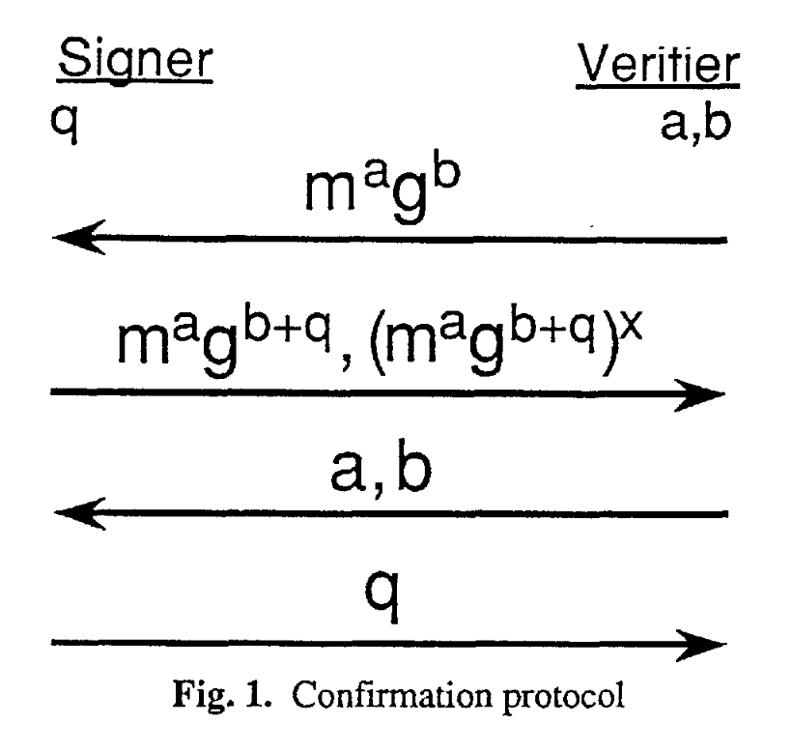
Signatures Confirmation Diagram (1991)
Notes:
Bob picks two random numbers: a and b, and uses them to blind the message, sending to Alice: c = mªg^{b}.
Alice picks a random number, q, uses it to blind, c, and then signing this using her private key, x, sending to Bob: s₁ = cg^{q} and s₂ = s₁^{x}. Note that s₁^{x} = (cg^{q})^{x} = (mªg^{b})^{x}g^{qx} = (m^{x})ª(g^{x})^{b+q} = zªy^{b+q}.
Bob reveals a and b.
Alice verifies that a and b are the correct blind values, then, if so, reveals q. Revealing these blinds makes the exchange zero knowledge.
Bob verifies s₁ = cg^{q}, proving q has not been chosen dishonestly, and s₂ = zªy^{b+q}, proving z is valid signature issued by Alice's key. Note that zªy^{b+q} = (m^{x})ª(g^{x})^{b+q}.

Slide 16
Practical Applications
Authentication systems - Prove ID or secret Information
Ethical Behavior - force proof of actions are good without revealing actions
Cryptocurrency - independent and asynchronous verification
Even used in nuclear disarmament
Notes:
Both

Slide 17
return 0;

Slide 18
References
https://www.circularise.com/blogs/zero-knowledge-proofs-explained-in-3-examples
https://en.wikipedia.org/wiki/Zero-knowledge_proof
https://www.cs.princeton.edu/courses/archive/spr06/cos522/ip.pdf
https://en.wikipedia.org/wiki/Interactive_proof_system
https://www.cs.cornell.edu/~rafael/papers/bbZK.pdf
https://research.ibm.com/projects/zero-knowledge-proofs
http://people.csail.mit.edu/silvio/Selected%20Scientific%20Papers/Proof%20Systems/The_Knowledge_Complexity_Of_Interactive_Proof_Systems.pdf

